Slide 1

KRISHI MITRA
B. V. V. Sangha’s
BASAVESHWAR ENGINEERING COLLEGE (Autonomous)
BAGALKOT
Presented By:
Rutwik Patil
Suresh Kengalagutti
Vishal Sarikdar
Project Guide:
Dr B. G. Shepperamatti

Slide 2
FUNCTIONS OF PROTOTYPE
Automatic Seed Sowing
Watering of plants
Pesticide/Insecticide Application
Fully Automatic
IOT platform controllable
Working Video Live stream to Smartphone

Slide 3
Disadvantages of Present Machines
Advantages of KRISHI MITRA
Each work needs to be done separately
Huge, Bulky Machines
Expensive
Has to be carried out mechanically
Cost efficient
Can be controlled from anywhere(via IOT)
Multipurpose system
Easy to install and operate
Low power consumption
Automatic
Image processing capability

Slide 4
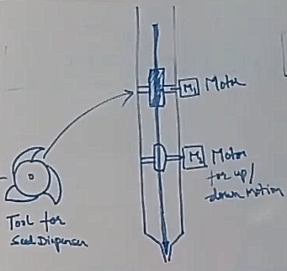
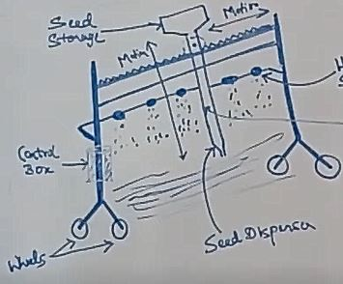
SEEDING TOOL & ROUGH DIAGRAM OF MACHINE

Slide 5
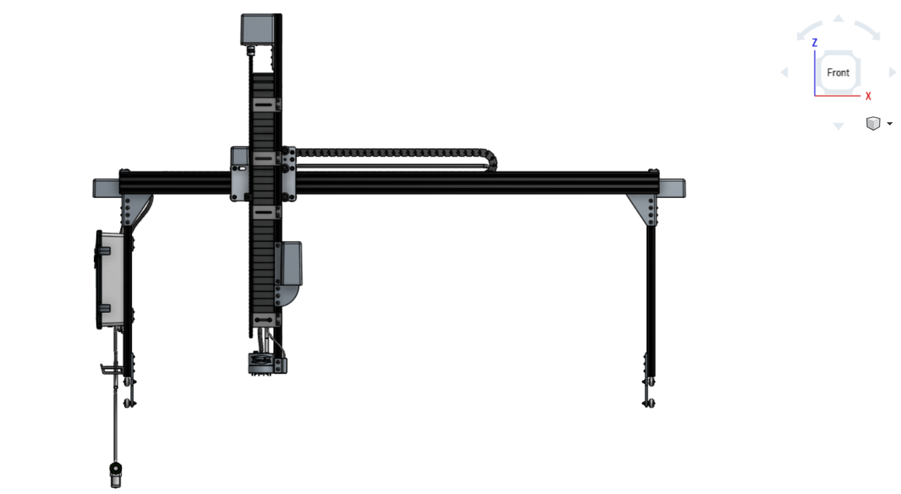
CAD MODEL OF PROPOSED MACHINE

Slide 6
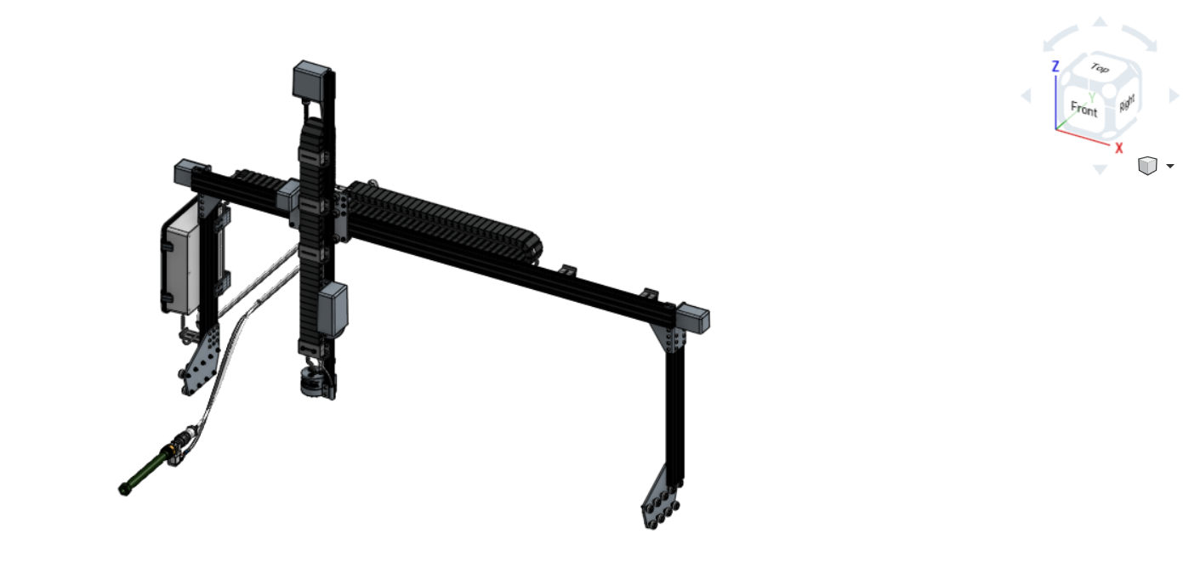

Slide 7
THANK YOU

